Slide 1
JPMorgan Probe Revived by Regulators’ Data Mining

Slide 2
What Happened?
Seven years ago, JPMorgan was investigated for a potential price fixing scheme.
Major Problem was lack of data to support the price fixing claim.
Just last week, investigators placed a $920 million dollar fine on the company for manipulating the trading price of silver.
This amounts to be the largest fine in company history.

Slide 3
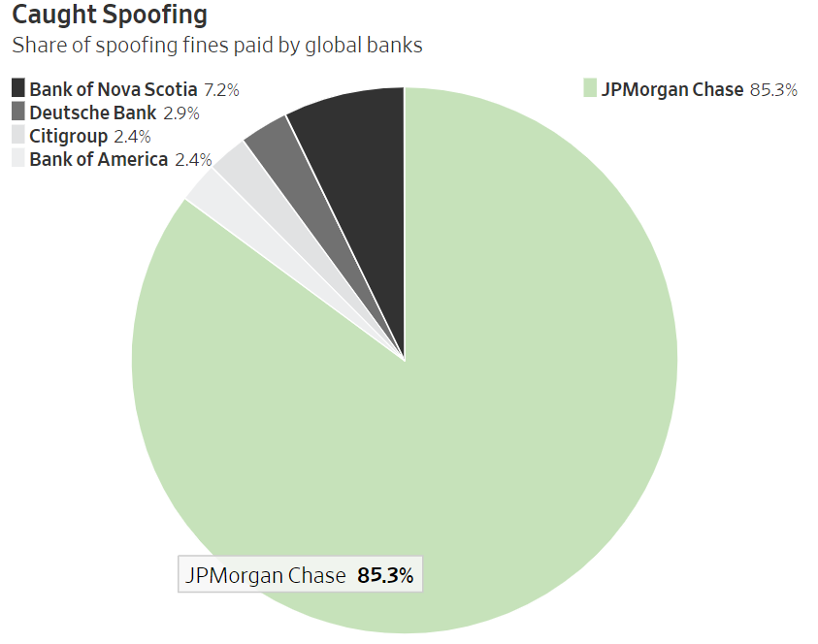
JPMorgan shares a massive percentage of the spoofing fines paid by all global banks
The CFTC has gone after JPMorgan multiple times with the latest being the largest given to the company.
Spoofing is not permitted by the CFTC and occurs when traders place, and cancel orders in the marketplace, to change the perceived supply and demand

Slide 4
How were they caught?
A company based out of Chicago called the CME group manages exchanges of Gold and Silver.
With the data accumulated over the past eight years the group was able to provide to the Commodity Futures Trading Commission enough information for them to bring up charges on the price fixing claim.
The data that was collected on these trades amounted to 1.7 Terabytes
Equivalent to over one hundred million pages of data.

Slide 5
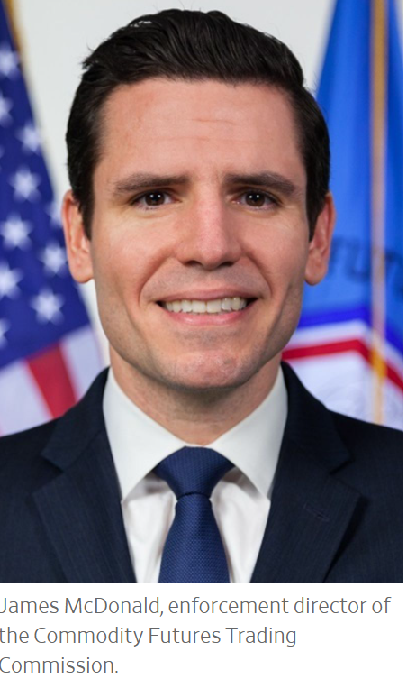
How Ctd.
The CFTC made a wise decision to hire former Chicago based traders in order to create software that would help the CFTC crack down on price fixing schemes like the eight year scheme by JPMorgan.
Increase in cloud computing data for the CFTC.
This gave them great insight into how to stop the problem.
“There is really no other avenue that we have that allows us to be as proactive [investigating] as data,”- James McDonald, Enforcement director at the CFTC.

Slide 6
What else did JPMorgan do wrong?
JPMorgan also admits to misconduct with trading U.S treasuries.
Both traders that were already indicted on charges and who were not.
The deal made with JPMorgan forced the company to admit to multiple wrongdoings in exchange for not charging them with wire fraud as well.
Deal helps JPMorgan but could damage future reputation.

Slide 7
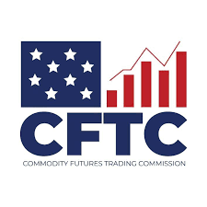
Other Complications
Multiple JPMorgan employees attempted to throw CFTC investigators off of the silver market fluctuations.
CTFC has had over sixty spoofing, and other price fixing related cases since 2013.
Cracking down due to advancements in data technology.

Slide 8
Reactions from the market
Many believe that JPMorgan needed a larger punishment.
“Better Markets, a group that advocates for stricter financial regulation, said the outcome was “grossly inadequate””
The company has a long history with illegal actions labeled by the CFTC.

Slide 9
Results of Stricter CFTC Regulation
The CFTC has seen a significant decrease in spoofing due to the technology.
Increasingly Intelligent software has allowed for the regulating agency to have seen significant drops in spoofing since “even three years ago.”
The CFTC believe that traders have begun to find new ways to get around market spoofing regulation.
Constant battle Regulators vs Trading companies.

Slide 10
Sources
https://www.wsj.com/articles/jpmorgan-probe-revived-by-regulators-data-mining-11601892000?mod=hp_lead_pos2

